Slide 1

Vehicle Detection Neural Network Project
Scientific Computing Department

Slide 2
Project Overview
Project Description:
This project aims to classify images to detect whether they contain a vehicle or not using a CNN (Convolutional Neural Network).
Project Workflow:
Abstract (about what did you do?)
Dataset description
Results
Comparison between models
Determine the best and whys

Slide 3
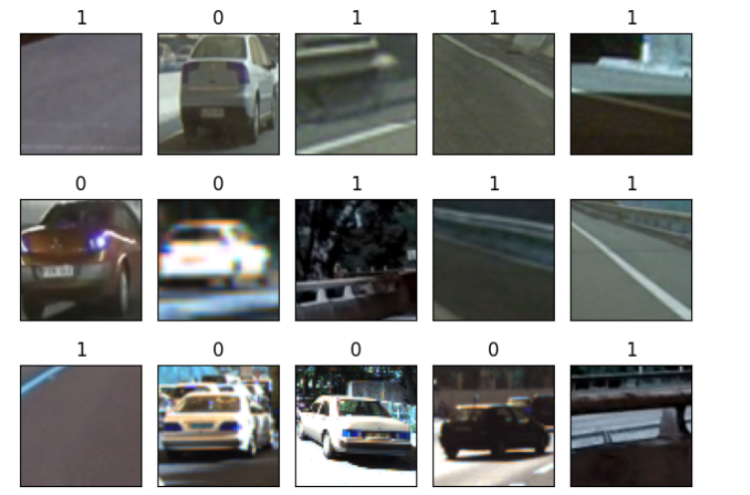
1. Abstract
This project aims to classify vehicle and non-vehicle cells using deep learning models, including CNN, VGG19, and ResNet50, trained on a dataset of cell images. Transfer learning techniques are employed by leveraging pre-trained models such as VGG19 and ResNet50. The models' performances are evaluated using metrics like F1 score and confusion matrices, with a comparison of their accuracies presented through a bar plot visualization. The study demonstrates the effectiveness of deep learning in malaria detection through image classification.

Slide 4
2. Dataset description
This dataset is for the machine learning process and Deep Learning.
Two labels:
Non-Vehicles
Vehicles
Contains: 17760 images

Slide 5
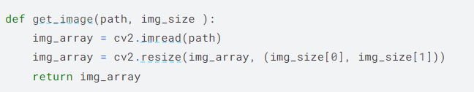
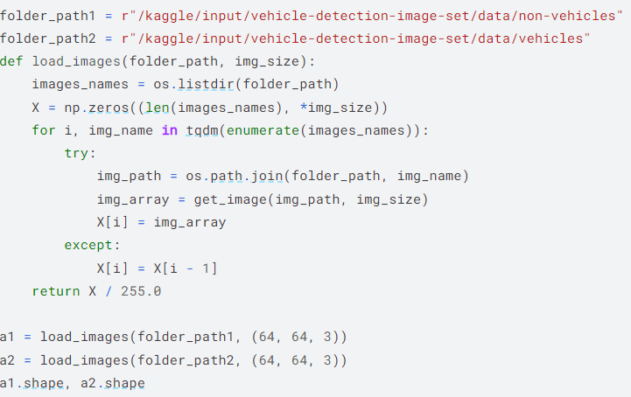
3. Results
1.Load The Images:
These Two cells define functions to load and preprocess images for a vehicle detection dataset. The get_image function loads an image from a given path and resizes it to a specified size, while load_images iterates through images in a folder, applies get_image, and normalizes them. a1 and a2 contain the processed images for the vehicle and non- vehicle classes, respectively, with shapes indicating the number of images and their dimensions.

Slide 6
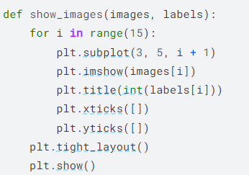
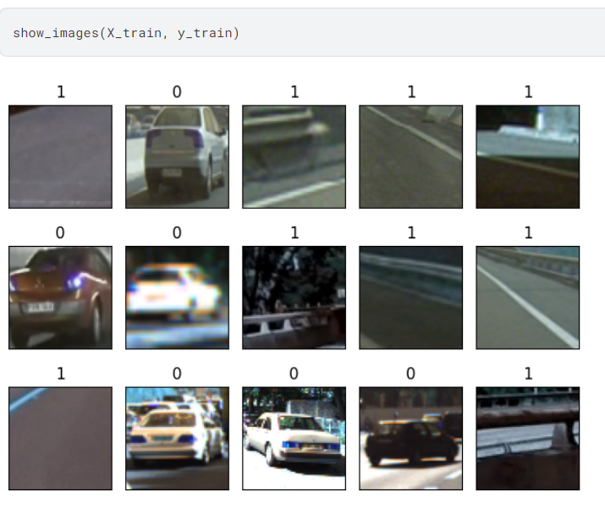
3. Results
2.Show Images:
This function displays a grid of images with their corresponding labels. It iterates through the first 15 images, plots them in a 3x5 grid, sets titles as their labels, and removes axis ticks for clarity. Finally, it adjusts the layout and shows the plot.

Slide 7


3. Results
3.Concatenate the data:
These lines create labels for the two classes: ones for class 1 (infected) and zeros for class 2 (uninfected), matching the lengths of the respective image arrays. Then, it concatenates the image arrays a1 and a2 along with their labels label1 and label2 to form the feature set X and the target set y. The shapes indicate the number of samples and their dimensions.

Slide 8
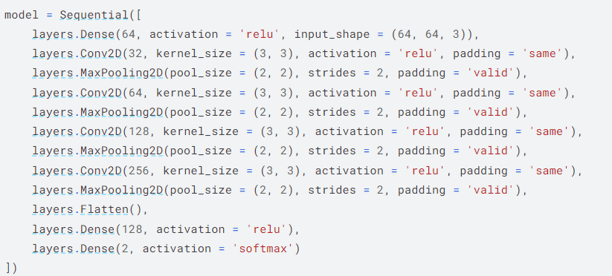
3. Results
4. Create our CNN Model for Image Classification:
defines a convolutional neural network (CNN) model for image classification. It consists of several layers including dense, convolutional, max-pooling, and flattening layers, followed by two dense layers with ReLU and softmax activations respectively. The input shape is specified as (64, 64, 3) for images of size 64x64 pixels with 3 color channels.

Slide 9
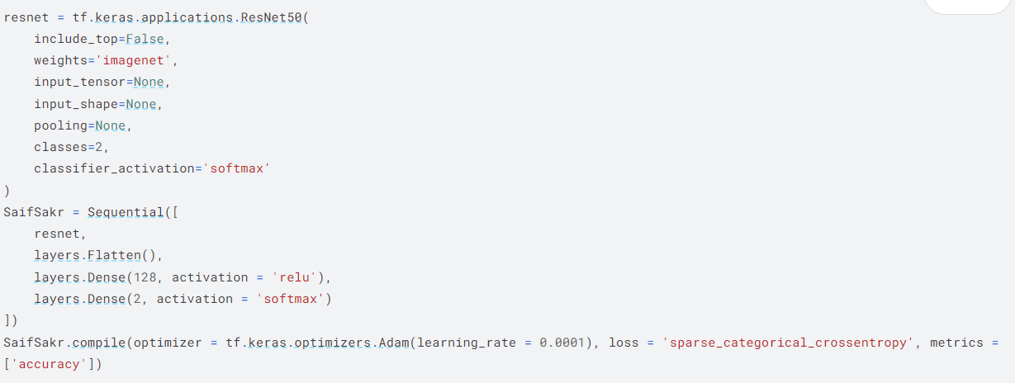
3. Results
5. Create our Transfer Learning Model (ResNet) for Image Classification:
employs transfer learning using the ResNet50 pre-trained model for image classification. It initializes ResNet50 with imagenet weights and removes the top classification layer. The model is then extended with additional layers for classification. It is compiled with Adam optimizer, sparse categorical crossentropy loss, and accuracy metrics.

Slide 10
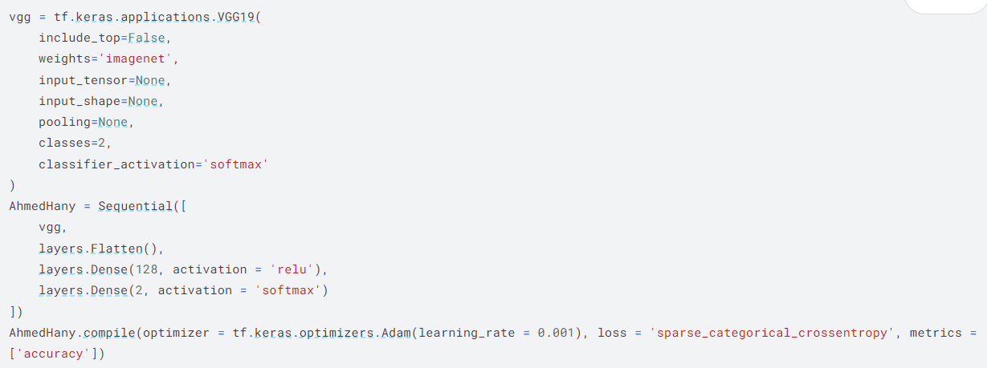
3. Results
6. Create our Transfer Learning Model (VGG19) for Image Classification:
utilizes transfer learning with the VGG19 pre-trained model for image classification. VGG19 is initialized with imagenet weights and the top classification layer is removed. The model is then extended with additional layers for classification. It is compiled with Adam optimizer, sparse categorical crossentropy loss, and accuracy metrics.

Slide 11
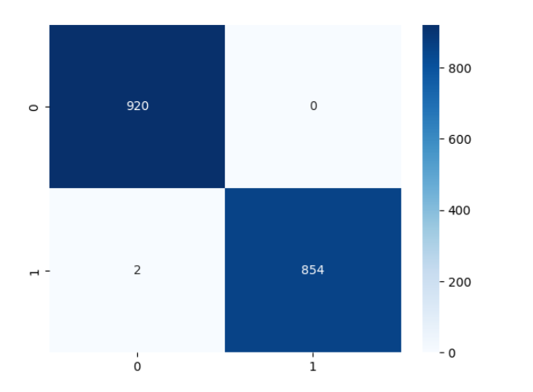
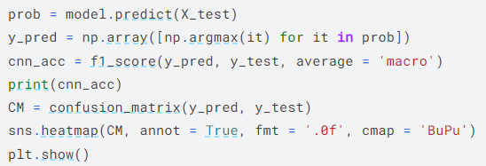
3. Results
7. Confusion Matrix for F1-Score for each model:
calculates the F1 score using the predictions from a CNN model on the test set and prints it. Then, it generates a confusion matrix based on the predicted and true labels and visualizes it using a heatmap.

Slide 12
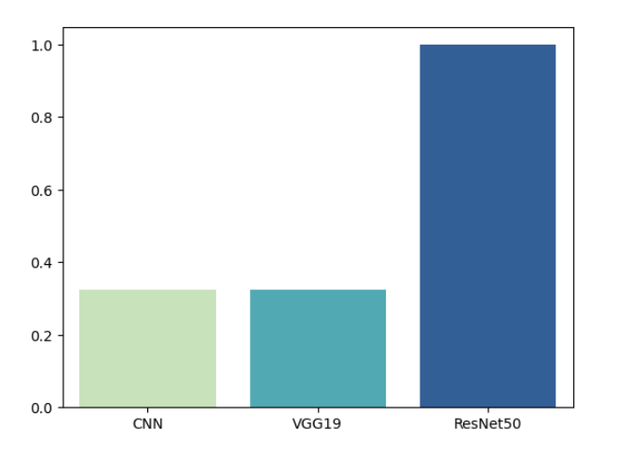
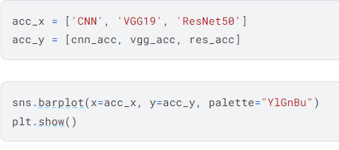
3. Results
7. Model Comparison:
This code creates a bar plot comparing the accuracy scores of different models (CNN, VGG19, ResNet50). It visualizes the accuracy scores using seaborn's barplot with a palette of "YlGnBu".

Slide 13
4. Comparison between models
This is a comparison between each model using a bar chart. This chart displays the accuracy for each model on a single graph.

Slide 14
Thanks! Neural Network Project

